Slide 1
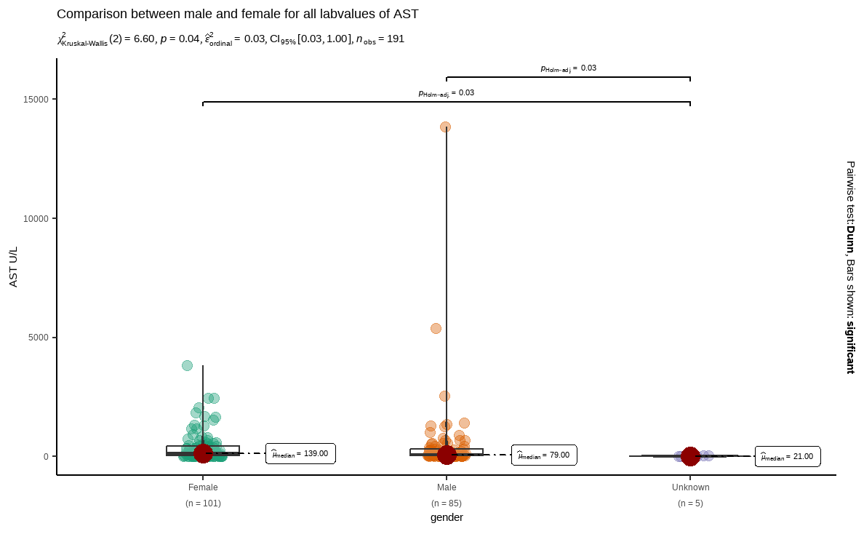
variable <chr> | gender <chr> | statistic <dbl> | p_value <dbl> | sample <dbl>
labreads | Female | 0.6416596 | 2.407640e-14 | 101
labreads | Male | 0.2704585 | 1.470567e-18 | 85
labreads | Unknown | 0.8668231 | 2.537967e-01 | 5

Slide 2
